Slide 1
Jasmine & Karma

Slide 2
Course Objective
AngularJs unit testing is executed with Karma and Jasmine
- Building blocks of Test
- BDD Architecture
- Equality Check
- Configuration

Slide 3
Jasmine

Slide 4
Jasmine - Introduction
Jasmine is a behavior-driven development framework for testing JavaScript code that plays very well with Karma.
Similar to Karma, it is the recommended testing framework within the AngularJS documentation.

Slide 5
Jasmine - Introduction
It is a simple API to test different components of JavaScript.
Jasmine is an open-source JavaScript framework, capable of testing any kind of JavaScript application.
Jasmine follows Behavior Driven Development (BDD) procedure to ensure that each line of JavaScript statement is properly unit tested.

Slide 6
Advantages
Jasmine does not depend on any other JavaScript framework.
Jasmine does not require any DOM.
All the syntax used in Jasmine framework is clean and obvious.
Jasmine is heavily influenced by Rspec, JS Spec, and Jspec.
Jasmine is an open-source framework and easily available in different versions like stand-alone, ruby gem, Node.js, etc.
Jasmine is one of the popular JavaScript unit testing frameworks which is capable of testing synchronous and asynchronous JavaScript code.

Slide 7
BDD Architecture

Slide 8
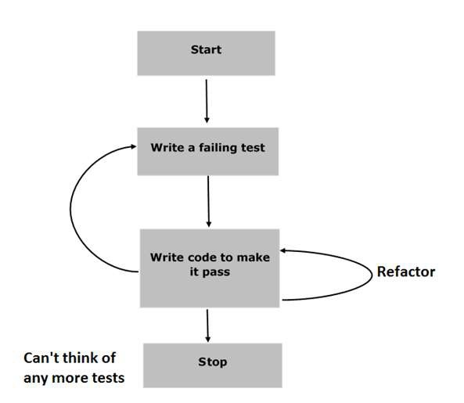
JasmineJS - BDD Architecture Cont…
Different phases of BDD framework.

Slide 9
JasmineJS - BDD Architecture Cont…
Step 1 − Start
In this phase, make the environment ready for Jasmine application.
Step 2 − Write a failing test
In this step, write the first ever test case. It is obvious that this test is going to fail because there is no such file or function to be tested.
Step 3 − Write a code to make it pass
In this phase, prepare the JavaScript file or function that needs to be tested. All the test cases prepared in the early stage should be successful.

Slide 10
JasmineJS - BDD Architecture Cont…
Step 4 − Refactor
Refactor is a very important phase of BDD model prepare many test cases for the particular application or function.
Step 5 − Stop
If everything is going well then the application must be ready and up. So we can consider this step as an end of our BDD application.

Slide 11
Building blocks of Test

Slide 12
Suite Cont…
A Jasmine suite is a group of test cases that can be used to test a specific behavior of the JavaScript code (a JavaScript object or function).
This begins with a call to the Jasmine global function with two parameters
– first parameter represents the title of the test suite
– second parameter represents a function that implements the test suite.
//This is test suite
describe("Test Suite", function() {
//.....
});

Slide 13
Suite
Jasmine is a testing framework for JavaScript. Suite is the basic building block of Jasmine framework. The collection of similar type test cases written for a specific file or function is known as one suite. It contains two other blocks, one is “Describe()” and another one is “It()”.
One Suite block can have only two parameters, one “name of that suite” and another “Function declaration” that actually makes a call to our unit functionality that is to be tested.

Slide 14
Spec Cont…
A Jasmine spec represents a test case inside the test suite.
This begins with a call to the Jasmine global function it with two parameters
– first parameter represents the title of the spec
– second parameter represents a function that implements the test case.

Slide 15
Spec
Spec contains one or more expectations.
Each expectation represents an assertion that can be either true or false.
In order to pass the spec, all of the expectations inside the spec have to be true.
If one or more expectations inside a spec is false, the spec fails.
//This is test suite
describe("Test Suite", function() {
it("test spec", function() {
expect( expression ).toEqual(true);
});
});

Slide 16
Describe & IT block
Describe Block
Describe block is a part of Suite block. Like Suite block, it contains two parameters, one “the name of the describe block” and another “function declaration”.
IT Block
It goes within a describe block. This is the block which actually contains each unit test case.

Slide 17
Expect Block
Expect Block
Jasmine Expect allows you to write your expectation from the required function or JavaScript file. It comes under IT block. One IT block can have more than one Expect block.
Following is an example of Expect block.
This expect block provides a wide variety of methods to unit test JavaScript function or JavaScript file. Each of the Expect block is also known as a matcher. There are two different types of matchers, one inbuilt matcher and another user defined matchers.

Slide 18
Equality Check

Slide 19
Equality Check Cont…
toEqual()
toEqual() is the simplest matcher present in the inbuilt library of Jasmine. It just matches whether the result of the operation given as an argument to this method matches with the result of it or not.
not.toEqual()
not.toEqual() works exactly opposite to toEqual(). not.toEqual() is used to check if the value does not match with the output of any function.

Slide 20
Equality Check Cont…
toBe()
toBe() matcher works in a similar way as toEqual(), however they are technically different from each other.
toBe() matcher matches with the type of the object whereas toEqual() matches with the equivalency of the result.

Slide 21
Equality Check
not.toBe()
not is nothing but a negation of the toBe() method. It fails when the expected result matches with the actual output of the function or JavaScript file.

Slide 22
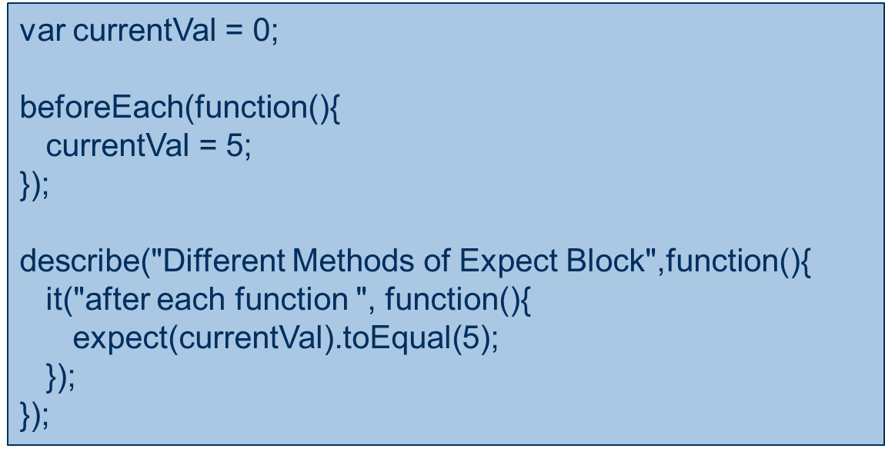
Before & After
The beforeEach function is called once before each spec in the describe in which it is called

Slide 23
Before & After
the afterEach function is called once after each spec.
var currentVal = 0;
afterEach(function(){
currentVal = 5;
});
describe("Different Methods of Expect Block",function() {
it("first call ", function(){
expect(currentVal).toEqual(0);
});
it("second call ", function() {
expect(currentVal).toEqual(5);
}); });

Slide 24
Configuration

Slide 25
Karma
Karma is a test runner provided by the Angular team.
Karma will execute tests in multiple browsers which shall ensure the application is compatible in all browsers.

Slide 26
Setting up Karma
Install karma for development purposes
$ npm install --save-dev karma
Install karma command line interface globally
$ npm install -g karma-cli

Slide 27
Configuring Test Runner
Install karma plug-ins to enable us to use Jasmine test framework and Google Chrome as target browser
$ npm install jasmine-core karma-jasmine karma-chrome-launcher --save-dev
Create a configuration file for the karma settings
$ karma init karma.conf.js

Slide 28
Writing Test and Execution
Step 1 − Create a Web application in the IDE
Step 2 – Add the Maven dependency
Step 3 – Create a Type script file
Step 4 – Create a Test case
Step 5 – Execute by running spec.ts file

Slide 29
Sample Code
describe('JavaScript addition operator', function () {
it('adds two numbers together', function () {
expect(1 + 2).toEqual(3);
});
});
Inside that it block, write all the setup code needed for the test.
Value passed in the expect will be tested.

Slide 30
Summary
Jasmine is a javascript unit testing framework and will provide the utilities to test the application
Karma is a test runner
Unit testing is a process in which these small units of your code are tested to ensure their proper operation

